Slide 1

UMW Fixed Assets
Updated FY27

Slide 2
Tania Ellis
Senior Accountant – Fixed Assets
tellis2@umw.edu
Eagle Village, Ste 480
x1244
Susan Beaver
Fixed Asset Coordinator
sbeaver@umw.edu
Eagle Village, Ste 480
x1221

Slide 3
What is a Fixed Asset?
Equipment (plus the cost to obtain or put in service) with a cost of $2,000.00 or greater
ETF equipment (plus the cost to obtain or put in service) with a cost of $500 or greater.
Is complete itself, does not lose identity or become a component of the building where it resides, is durable, and expected to have a service life of more than one year.
Some examples:
  Office Furniture
  Computer/Laptop
  Printer
  Microscope / Lab Equipment
  Motor Vehicle
  AV System

Slide 4
UMW’s Fixed Assets
To date, we currently have 4470 tagged Fixed Assets on our books, not to include intangible software, buildings and new construction.
Total cost of approximately $40M
Fixed Assets range in cost from $500-$2.7M
Useful life is determined by UMW’s general practices and the Commonwealth of Virginia, though a typical life cycle ranges from 5-10 years.
ETF Funded Fixed Assets have a useful life of seven years, computers have a useful life of three years.
Fixed Assets directly impact UMW’s Financial Statements.
Capital Assets (assets that are valued at $5,000 or greater) are audited by APA every fiscal year.

Slide 5
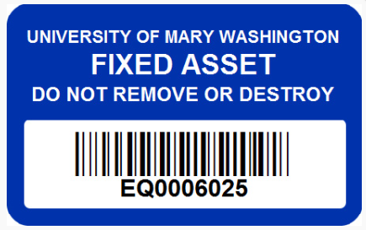
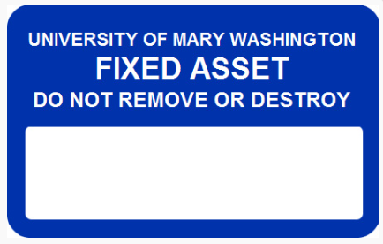

Fixed Asset Tags
EQ (issued by Accounting)
DP (issued by IT)
DA (issued by Dahlgren IT)
AV (Issued by IT/AV)
GF (issued by Accounting)
ETF – Equipment Trust Fund (grant money from the Commonwealth of Virginia)
Replacement Tags
A (Aggregate issued by Accounting)
N (Intangible issued by Accounting/Finance)
Fixed Asset Tags are tracked and verified on an continual basis.
Fixed Asset Tag numbers are entered into Banner to properly account for and depreciate assets with information that comes directly from purchase order entries.

Slide 6
Aggregate Assets
A group of tangible capital assets where the value of the group meets the capitalization threshold of $10,000 or greater.
Aggregate assets are evaluated at the Purchase Order level for the total purchase of like items that have a cost of $10,000 or more and are required to use an “A” account code.
  Examples:
    Order for 10 laptops at $1,000 each
    Order for 12 dehumidifiers at $834 each
    Order for 6 hot water heaters at $1,700 each
    Order for 25 high-back chairs at $400 each
    Order for 5 computers at $2,000 each
Aggregate assets will be assigned a Tag Number in Banner with the prefix AG (AG0000001) and are used for financial tracking purposes.
Recorded Aggregate Assets totaled approximately $3M.

Slide 7
Fixed Asset Purchase Orders
Aggregate Assets Purchase Orders
$2,000 minimum per piece of equipment/functional unit (including labor/install, shipping, credit card fees)
  $500 minimum for ETF purchases
eVA orders are placed using an account code that ends with an “F”
eVA Line Items generate temporary tags
Quantity and Cost
  Q1 x $5,780 = $5,780 FIXED ASSET
  Q8 x $540 = $4,320 NOT FIXED ASSET
  Q2 x $2,000 = $4,000 FIXED ASSET
Line Item Description – be as descriptive as possible!
  Always include: Manufacturer, Model Number and Item Description
BEST practice include in comment section:
  Custodian’s Name/Building and Room Number of where fixed asset will be located
$10,000 minimum for grouping of like items (including labor/install, shipping, credit card fees)
eVA orders are placed using an account code that ends with an “A”
eVA Line Items generate temporary tags
Quantity and Cost
  Q4 x $1280 = $5,120 NOT AGGREGATE
  Q8 x $1250 = $10,000 AGGREGATE
  Q5 x $2000 = $10,000 AGGREGATE
Line Item Description – be as descriptive as possible!
  Always include: Manufacturer, Model Number and Item Description
BEST practice include in comment section:
  Custodian’s Name/Building and Room Number of where aggregate assets will be located

Slide 8
Banner Entry of Fixed and Aggregate Assets
The required information needed for Banner entry:
  Date Equipment is Received or Date Equipment is Installed (I use the Banner received date Y#, but reach out to buyers for SPCC/Finance Card purchases)
  Location (Building and Room Number)
  Fixed Asset Custodian (who knows where the equipment is and can answer any questions about it during a physical inventory)
  Total Cost to include Labor/Installation, Delivery, Credit Card Fees, etc.
  A fully-executed Purchase Order
  Invoice for assets $5,000 and greater
    Invoices should be as detailed as possible and should include item descriptions, quantities and cost
Fixed and Aggregate Assets must be entered into Banner within 90 days from date of receipt of goods or installation.
APA requests the following information during an audit:
  Invoice, purchase order, proof of receiving (or installation) date, capitalization and depreciation information to ensure that process was completed within 90 days, pictures of asset and fixed asset tag, and any other information I have

Slide 9
Inventory
Surplus
Inventory on all capital equipment is completed biennially
Susan, our Fixed Asset Coordinator, conducts inventory based on Building an Custodian
We look for Fixed Asset Tag, verify serial number and location of asset
  In addition, we also verify and update custodial changes as needed
Once a building inventory is completed, all information is manually entered and updated in Banner
Missing items are checked (and rechecked) before notifying the Vice President of the respective area that an item is Lost and will be written off
Surplus is a physical location – Physical Plant Warehouse
  Surplus is not a dark closet, cabinet or garbage can!
When you surplus unused or broken items, they are moved to the Physical Plant for temporary storage, repurposed for other areas or are prepared to be sold, recycled and/or disposed of.
Surplussed Fixed Assets can be repurposed, sold or disposed of by David Wilt, the Warehouse Manager
Contact Central Storeroom to surplus unwanted items
  https://adminfinance.umw.edu/facilities/central-storeroomsurplus/

Slide 10
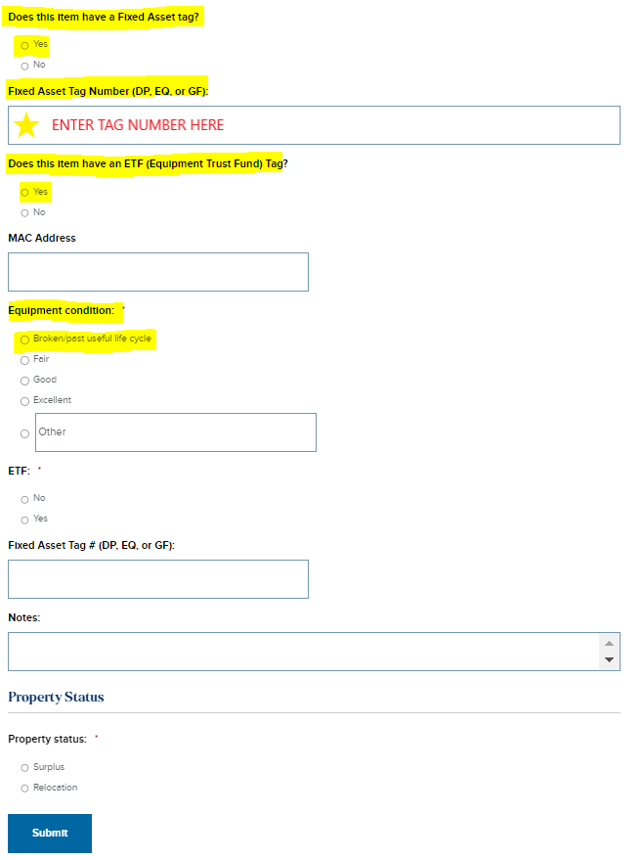
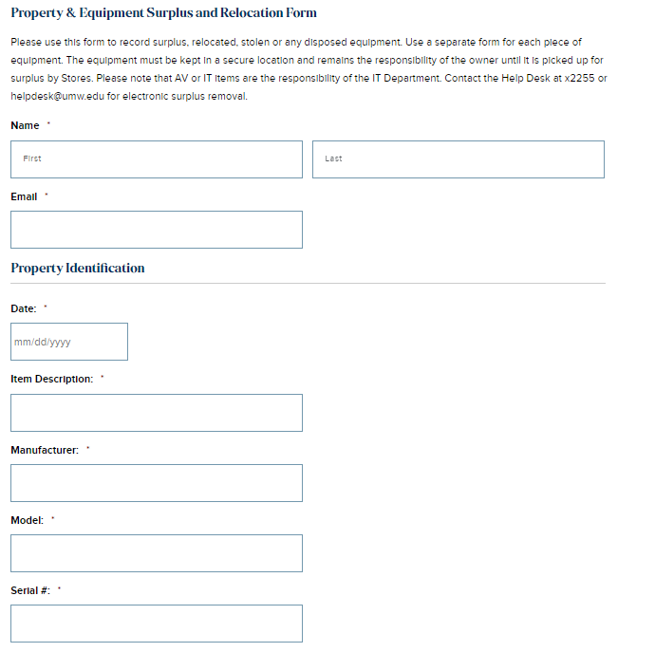
Surplus and Relocation Form
Surplus and Relocation Form

Slide 11
Additional Things to Note
I regularly review all university purchases over $2,000, regardless of account code, through both WORKS and eVA Reporting.
  In my review, I often find discrepancies between eVA order FOAPS and what is entered by Buyers in WORKS.
  I reach out to buyers to determine if something should (or shouldn’t) have been coded to a Fixed (or Aggregate) account code and often request the following information:
    Invoice
    Date Received (or Installed)
    Custodian and Location of Asset
Email me your invoices for equipment purchases over $5K when you do your Banner receiving for POs - you can cc me right along with AP.
BEST Practice - If you are getting ready to enter a Fixed or Aggregate Asset order in eVA, email me or call me! I will review your quote(s) and help you build your order in eVA so it can be done one time with no revisions.
  Particularly for orders that have multiple items and/or functional unit groups.
Email (or call) me if you have questions or need help!
  tellis2@umw.edu
  x1244

